Slide 1

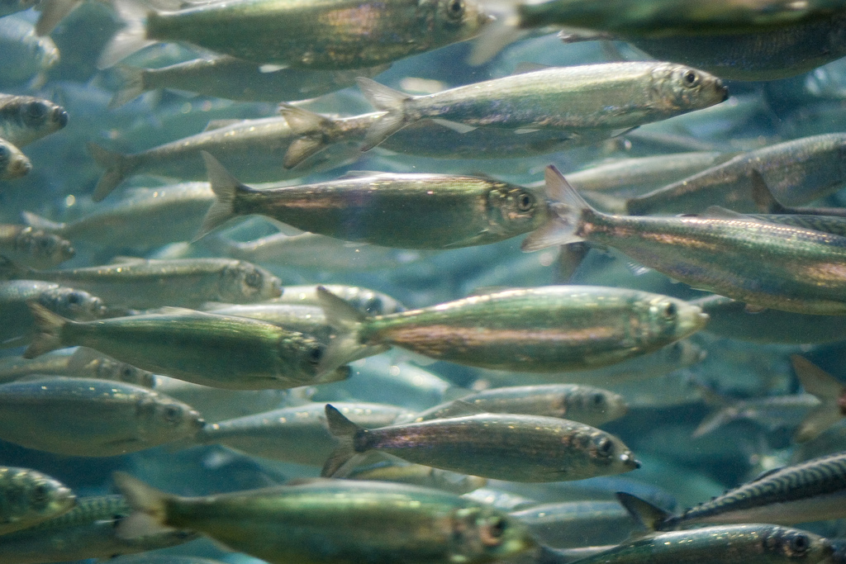
Uncertainty Estimation of the North Sea International Bottom Trawl Survey (IBTS) Abundance Indices
Natoya Jourdain
Finse March 7, 2018
*Olav Breivik, Edvin Fuglebakk, Jon Helge Vølstad and Sondre Aanes

Slide 2
Aims and Objectives
The North Sea IBTS aim to provide:
Information on seasonal distribution of stocks sampled, hydrography and the environment, and
use this to monitor changes in fish stocks and abundance of all species
Provide point estimates of catch in numbers at age but without assessing the accuracy of these estimates, i.e., without estimates of uncertainty, and
these indices are estimated using an Age-Length Key (ALK) method, which is assumed to be constant over relatively large areas
ALK: the proportion of ﬁsh in a length group that falls into a particular age-class
We propose a strong case for assuming variation in the ALK within these areas:
Provide two estimators which consider spatial variation in the data
Estimate uncertainty for the estimated parameters

Slide 3
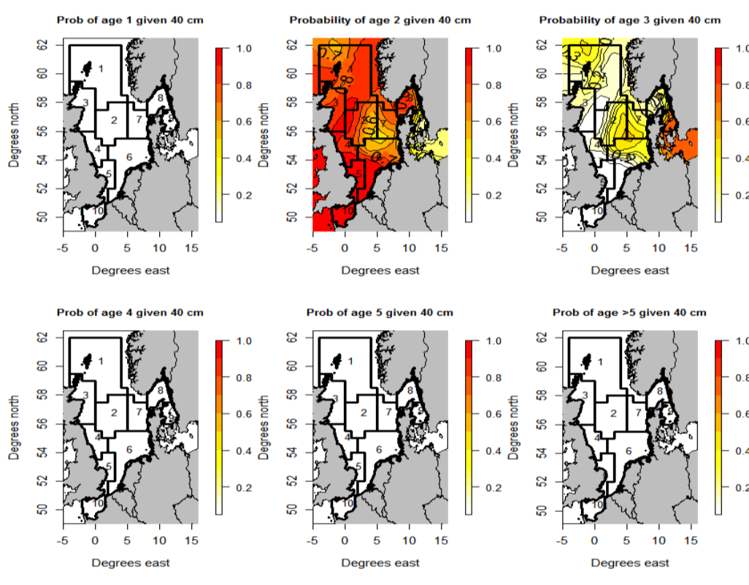
Aims and Objectives
Age distribution clearly varies for age 2 cod of length 40cm within Central North Sea and Northern North Sea

Slide 4
Overview of IBST
The North Sea IBTS was started by ICES in 1990. It is combination of
8 national surveys (1970’s and 1980’s) and,
The International Young Herring Survey (IYHS) in the North Sea, Skagerrak and Kattegat areas (1960’s), which aimed
to obtain annual recruitment indices for the combined North Sea Herring stock, but
valuable information on other species such as cod and haddock were obtained
IBTS began with quarterly surveys which became expensive to sustain as countries experience budget cuts
In 1997 countries carried surveys only twice a year
The first quarter (Q1) which is January – February: 7 nations take part
The third quarter (Q3) which is between July – August: 6 nations take part
These nations include: Denmark, France, Germany, Netherlands, Norway, UK England, UK Scotland and Sweden

Slide 5
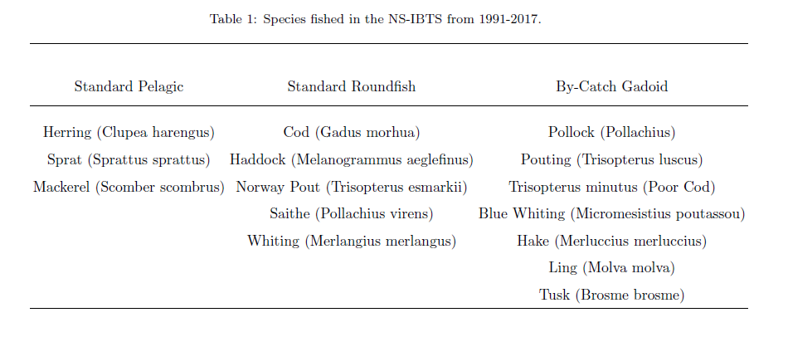
Overview of IBST
List of target species of the North Sea IBTS

Slide 6
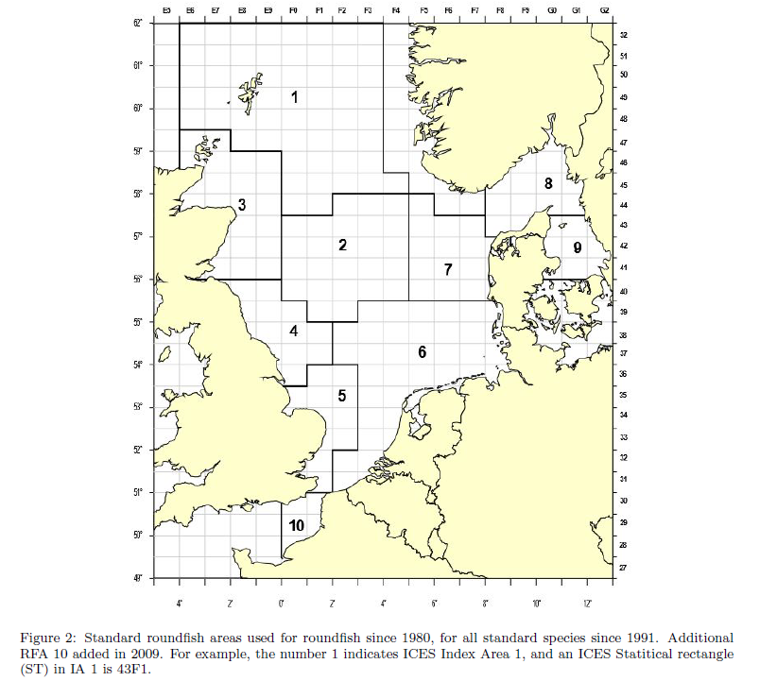
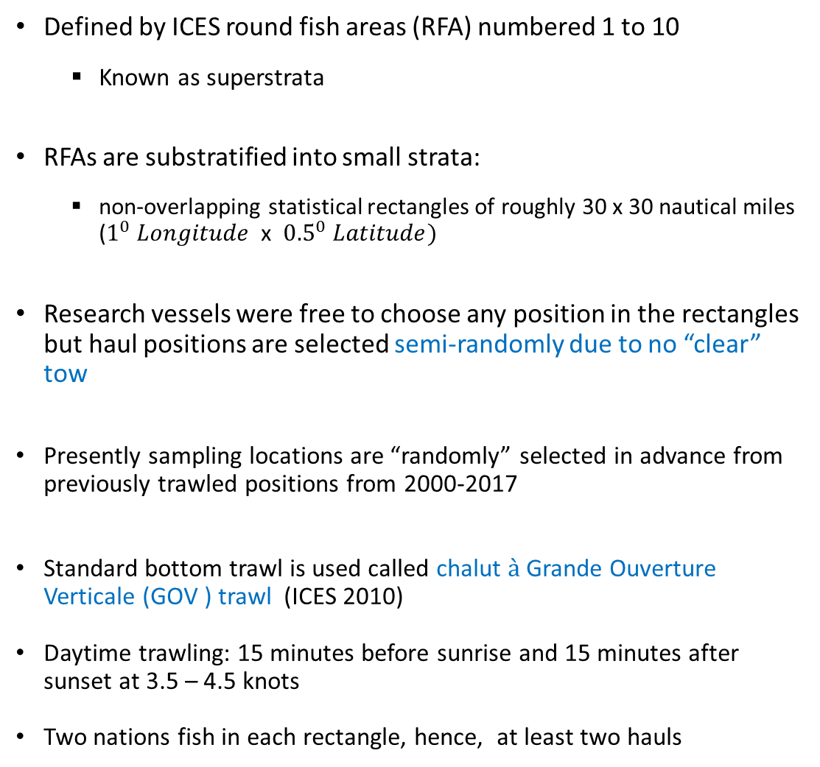
Sampling frame
Defined by ICES round fish areas (RFA) numbered 1 to 10
Known as superstrata
RFAs are substratified into small strata:
non-overlapping statistical rectangles of roughly 30 x 30 nautical miles ($1^{0} Longitude$x ${0.5}^{0} Latitude)$
Research vessels were free to choose any position in the rectangles but haul positions are selected semi-randomly due to no “clear” tow
Presently sampling locations are “randomly” selected in advance from previously trawled positions from 2000-2017
Standard bottom trawl is used called chalut $\grave{a}$ Grande Ouverture Verticale (GOV ) trawl (ICES 2010)
Daytime trawling: 15 minutes before sunrise and 15 minutes after sunset at 3.5 – 4.5 knots
Two nations fish in each rectangle, hence, at least two hauls

Slide 7
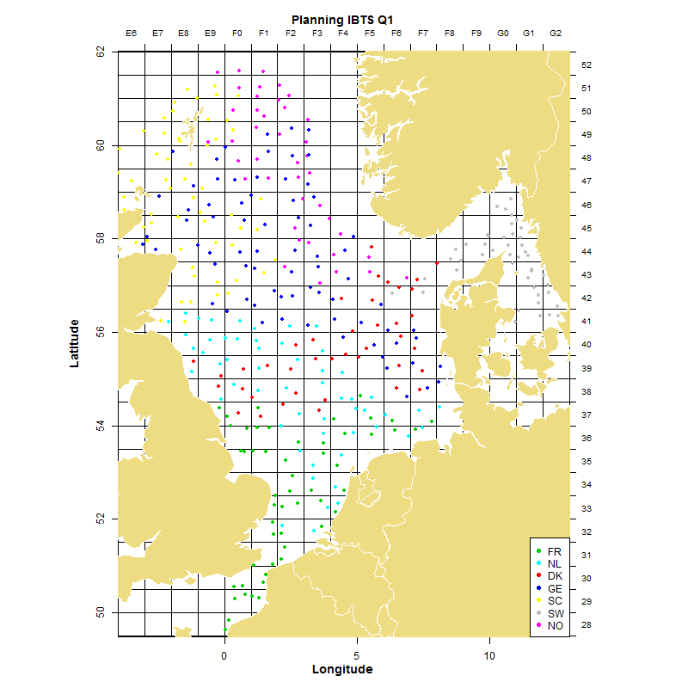
Sampling frame
IBTS Q1 2018 Sampling frame
Two nations fish in each rectangle, hence, at least two hauls
But for some rectangles one country would fish twice (or more)
Norway (pink) is partnered with Germany (Blue), Scotland (Yellow) and Denmark (red)

Slide 8
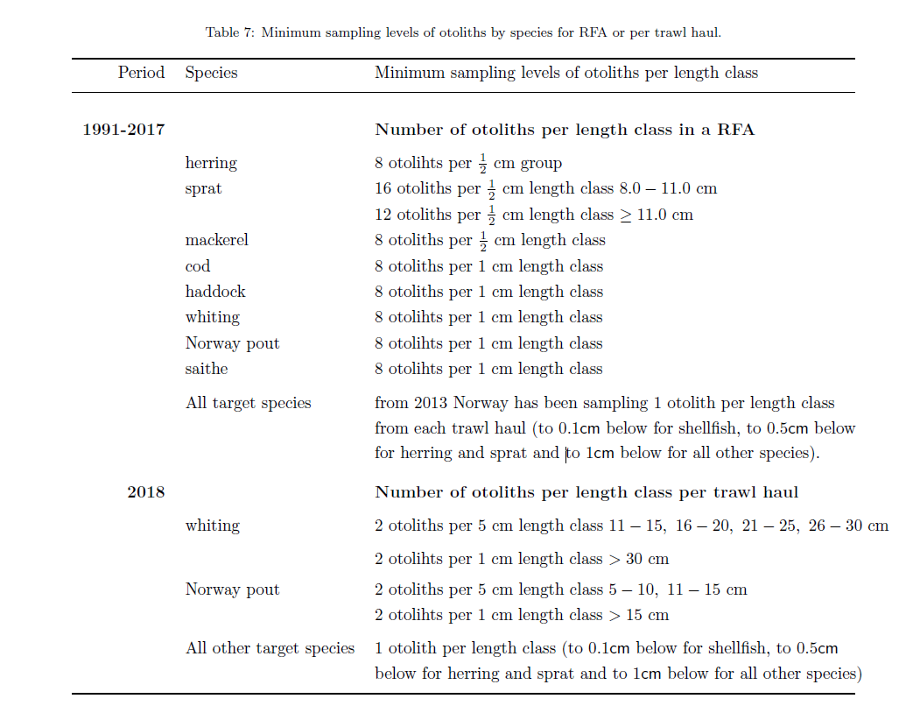
Sampling frame
Total catches for each trawl haul are computed on board
Biological parameters such as length are collected for all fish species
to 0.1cm below for shellfish,
to 0.5cm below for herring and sprat and
to 1cm below for all other species
Otoliths were and are sampled according to the Table
IBTS Q1 2018 Norway:
2 otoliths per 1 cm: Whiting and Norway Pout
1 otolith per 1 cm: all others
For large catches a subsample of 100 fish is taken

Slide 9
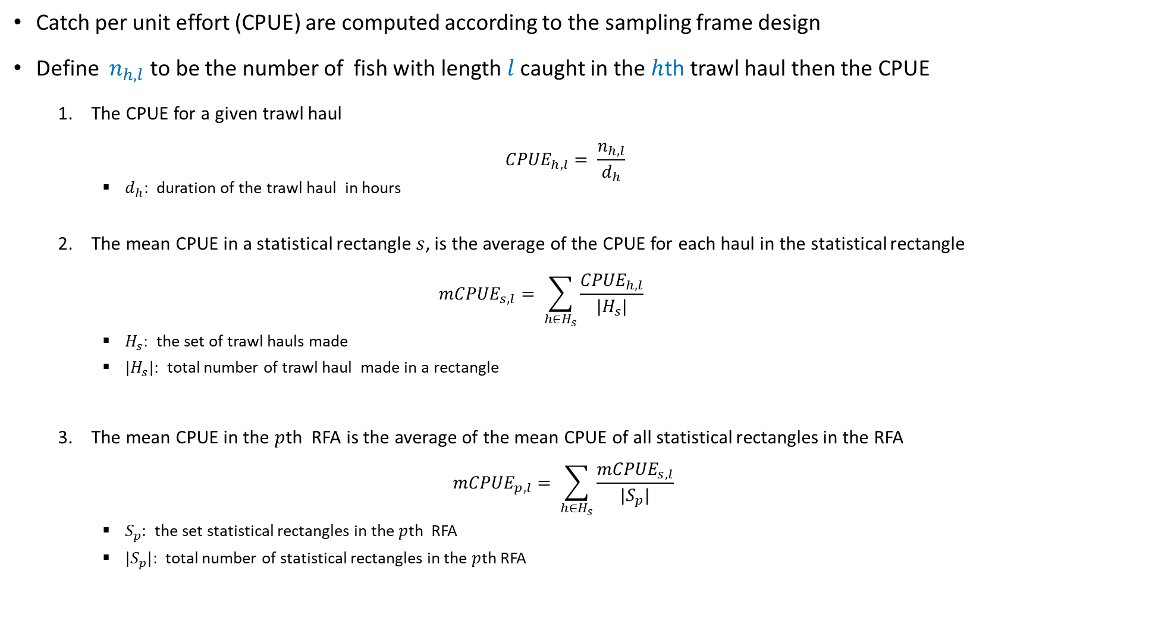
Methods
Catch per unit effort (CPUE) are computed according to the sampling frame design
Define $n_{h,l}$ to be the number of fish with length $l$ caught in the $h$th trawl haul then the CPUE
The CPUE for a given trawl haul
$${CPUE}_{h,l}= \frac{n_{h,l}}{d_{h}}$$
$d_{h}:$ duration of the trawl haul in hours
The mean CPUE in a statistical rectangle $s$, is the average of the CPUE for each haul in the statistical rectangle
$${mCPUE}_{s,l}= \sum_{h∈H_{s}}{\frac{{CPUE}_{h,l}}{|H_{s}|}}$$
$H_{s}:$ the set of trawl hauls made
${|H}_{s}|:$ total number of trawl haul made in a rectangle
The mean CPUE in the $p$th RFA is the average of the mean CPUE of all statistical rectangles in the RFA
$${mCPUE}_{p,l}= \sum_{h∈H_{s}}{\frac{{mCPUE}_{s,l}}{|S_{p}|}}$$
$S_{p}:$ the set statistical rectangles in the $p$th RFA
${|S}_{p}|:$ total number of statistical rectangles in the $p$th RFA

Slide 10
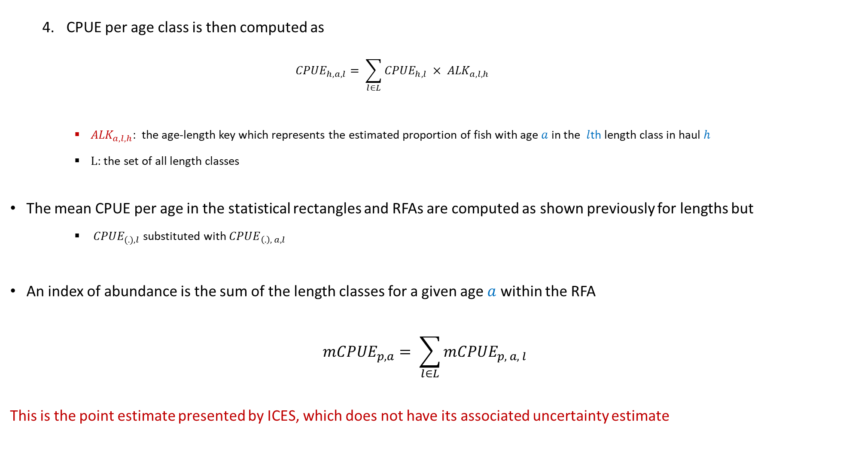
Methods
CPUE per age class is then computed as
$${CPUE}_{h,a, l}= \sum_{l∈L}{{CPUE}_{h,l}} × {ALK}_{a,l,h}$$
${ALK}_{a,l,h}:$ the age-length key which represents the estimated proportion of fish with age $a$ in the $l$th length class in haul $h$
$L$: the set of all length classes
The mean CPUE per age in the statistical rectangles and RFAs are computed as shown previously for lengths but
${ CPUE}_{(.),l}$ substituted with ${CPUE}_{\left(.\right), a, l}$
An index of abundance is the sum of the length classes for a given age $a$ within the RFA
$$m{CPUE}_{p,a}= \sum_{l∈L}{{mCPUE}_{p, a, l}}$$
This is the point estimate presented by ICES, which does not have its associated uncertainty estimate

Slide 11
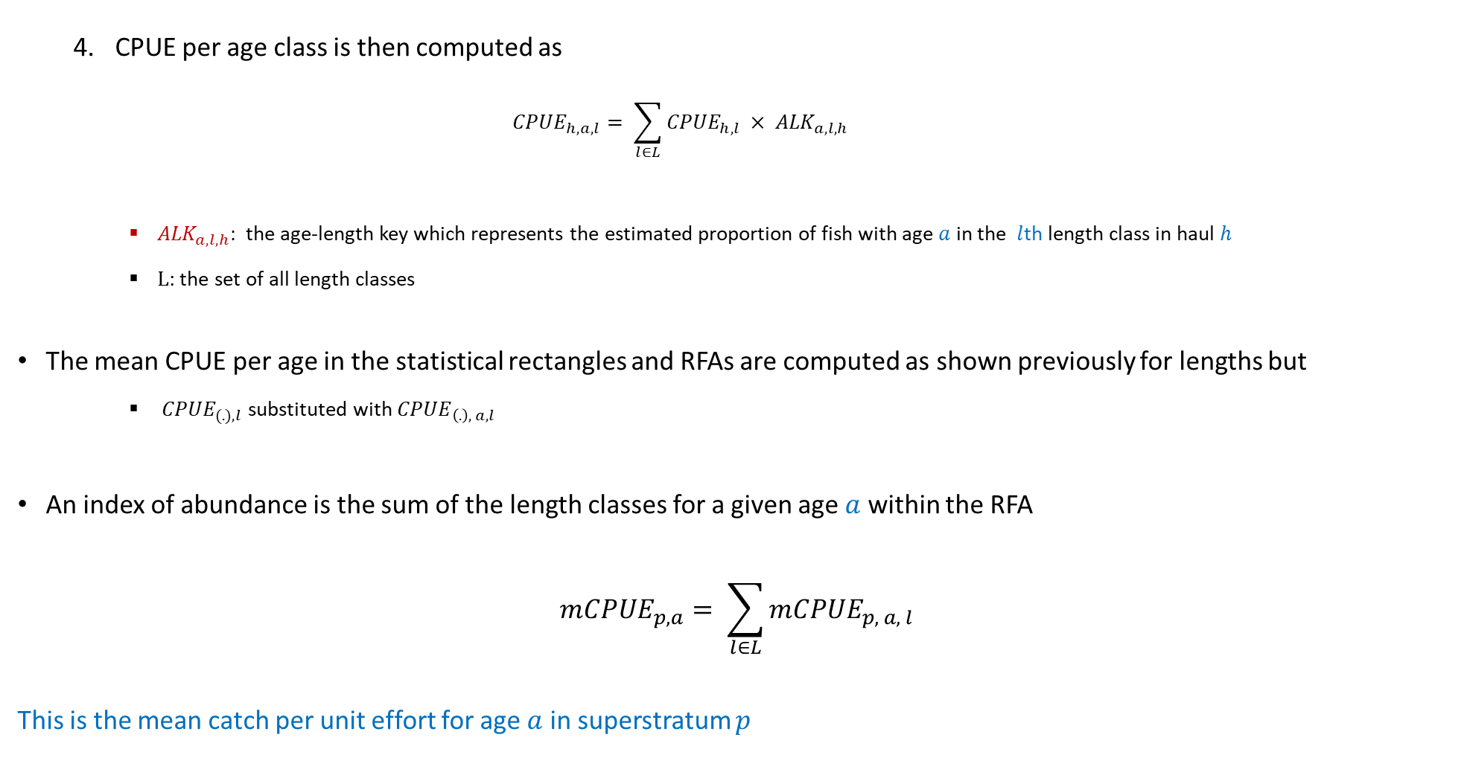
Methods
CPUE per age class is then computed as
$${CPUE}_{h,a, l}= \sum_{l∈L}{{CPUE}_{h,l}} × {ALK}_{a,l,h}$$
${ALK}_{a,l,h}:$ the age-length key which represents the estimated proportion of fish with age $a$ in the $l$th length class in haul $h$
$L$: the set of all length classes
The mean CPUE per age in the statistical rectangles and RFAs are computed as shown previously for lengths but
${ CPUE}_{(.),l}$ substituted with ${CPUE}_{\left(.\right), a, l}$
An index of abundance is the sum of the length classes for a given age $a$ within the RFA
$$m{CPUE}_{p,a}= \sum_{l∈L}{{mCPUE}_{p, a, l}}$$
This is the mean catch per unit effort for age $a$ in superstratum $p$

Slide 12
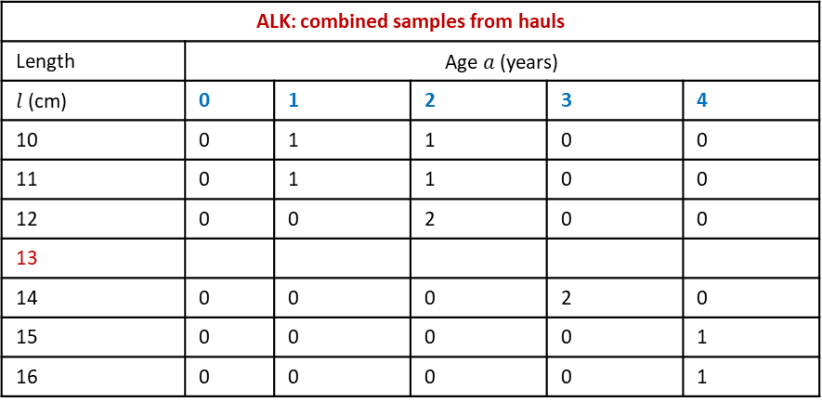
DATRAS ALK Estimator
This is an aggregation of individual samples from a haul combined over a RFA
Assumes age-length compositions are homogeneous within a RFA. This is not case as seen in age distribution Plot (2 – 40cm)
Violations of assumption will give bias results (Kimura, 1977)
+ =
Missing ALKs are imputed by extrapolation: taking averages and borrowing closest length group age-length composition
A single ALK for a RFA
Does not account for spatial variation in the data and as a consequence would result in
biased estimates, and
an underestimation of uncertainty
Haul ID: 11101
Length class (cm) | Age (years)
10 | 1
11 | 2
12 | 2
13
14 | 3
15 | 4
16
Haul ID: 56801
Length class (cm) | Age (years)
10 | 2
11 | 1
12 | 2
13
14 | 3
15
16 | 4
ALK: combined samples from hauls
Length | Age $a$ (years)
$l$(cm) | 0 | 1 | 2 | 3 | 4
10 | 0 | 1 | 1 | 0 | 0
11 | 0 | 1 | 1 | 0 | 0
12 | 0 | 0 | 2 | 0 | 0
13
14 | 0 | 0 | 0 | 2 | 0
15 | 0 | 0 | 0 | 0 | 1
16 | 0 | 0 | 0 | 0 | 1

Slide 13
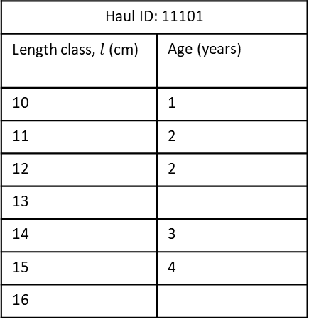

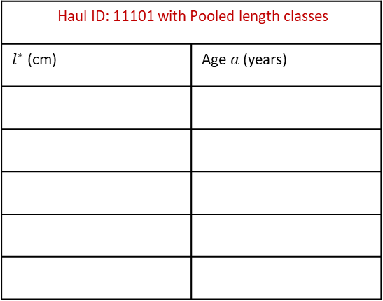
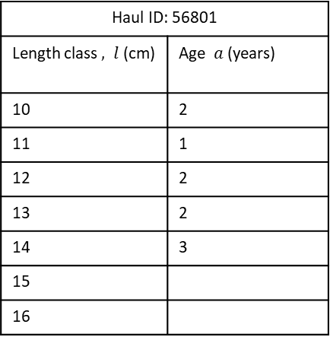
Haul-based ALK Estimator
Each trawl haul has an ALK
Few observed length classes in a single haul so
Length classes are pooled, $l^{∗}.$ First pooled length group consists of the five smallest length classes and so on
Search closest neighbour trawls in “air distance” for age-length compositions in the same pooled length group, if there are none
Fill in missing values using DATRAS approach
Accounts for the stratified sampling design and variation in age-length structures between trawl haul locations
Haul ID: 11101
Length class, $l$ (cm) | Age (years)
10 | 1
11 | 2
12 | 2
13
14 | 3
15 | 4
16
Haul ID: 56801
Length class $, l$(cm) | Age $a$(years)
10 | 2
11 | 1
12 | 2
13 | 2
14 | 3
15
16
Haul ID: 11101 with Pooled length classes
$l^{∗}$ (cm) | Age $a$(years)

Slide 14
Model-based ALK Estimator
Spatial model-based ALKs are widely used in fisheries (Berg and Kristensen, 2012; Gerritsen et al, 2006)
Statistical models allows:
the creation of a smooth distribution of age given length and possibly other covariates such haul location
filling in of missing values in a more objective and robust manner, while accounting for uncertainty arising due to sampling variability
We consider Logits: a type pf model for categorical response data (e.g., age groups)

Slide 15
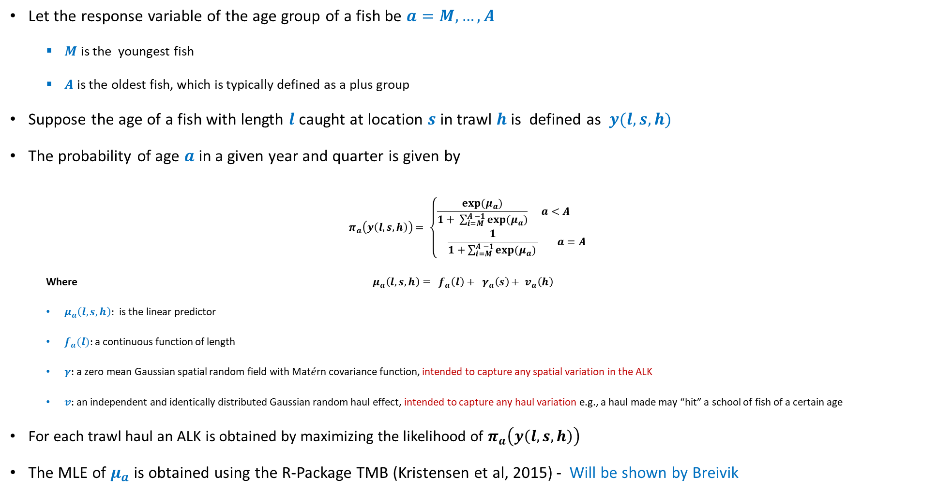
Model-based ALK Estimator
Let the response variable of the age group of a fish be $a=M,…, A$
$M$ is the youngest fish
$A$ is the oldest fish, which is typically defined as a plus group
Suppose the age of a fish with length $l$ caught at location $s$ in trawl $h$ is defined as $y(l, s, h)$
The probability of age $a$ in a given year and quarter is given by
$$π_{a}\left(y\left(l,s,h\right)\right)= \left\{\begin{matrix}\frac{exp⁡(μ_{a})}{1+ \sum_{i=M}^{A −1}{exp⁡(μ_{a})}} a<A \\ \frac{1}{1+\sum_{i=M}^{A −1}{exp⁡(μ_{a})} } a=A \end{matrix}\right.$$
Where $μ_{a}\left(l, s, h\right)= f_{a}\left(l\right)+ γ_{a}\left(s\right)+ v_{a}\left(h\right)$
$μ_{a}\left(l, s, h\right):$ is the linear predictor
$f_{a}(l):$ a continuous function of length
$γ:$ a zero mean Gaussian spatial random field with Mat$\acute{e}$rn covariance function, intended to capture any spatial variation in the ALK
$v:$an independent and identically distributed Gaussian random haul effect, intended to capture any haul variation e.g., a haul made may “hit” a school of fish of a certain age
For each trawl haul an ALK is obtained by maximizing the likelihood of $π_{a}\left(y\left(l,s,h\right)\right)$
The MLE of $μ_{a}$ is obtained using the R-Package TMB (Kristensen et al, 2015) - Will be shown by Breivik

Slide 16
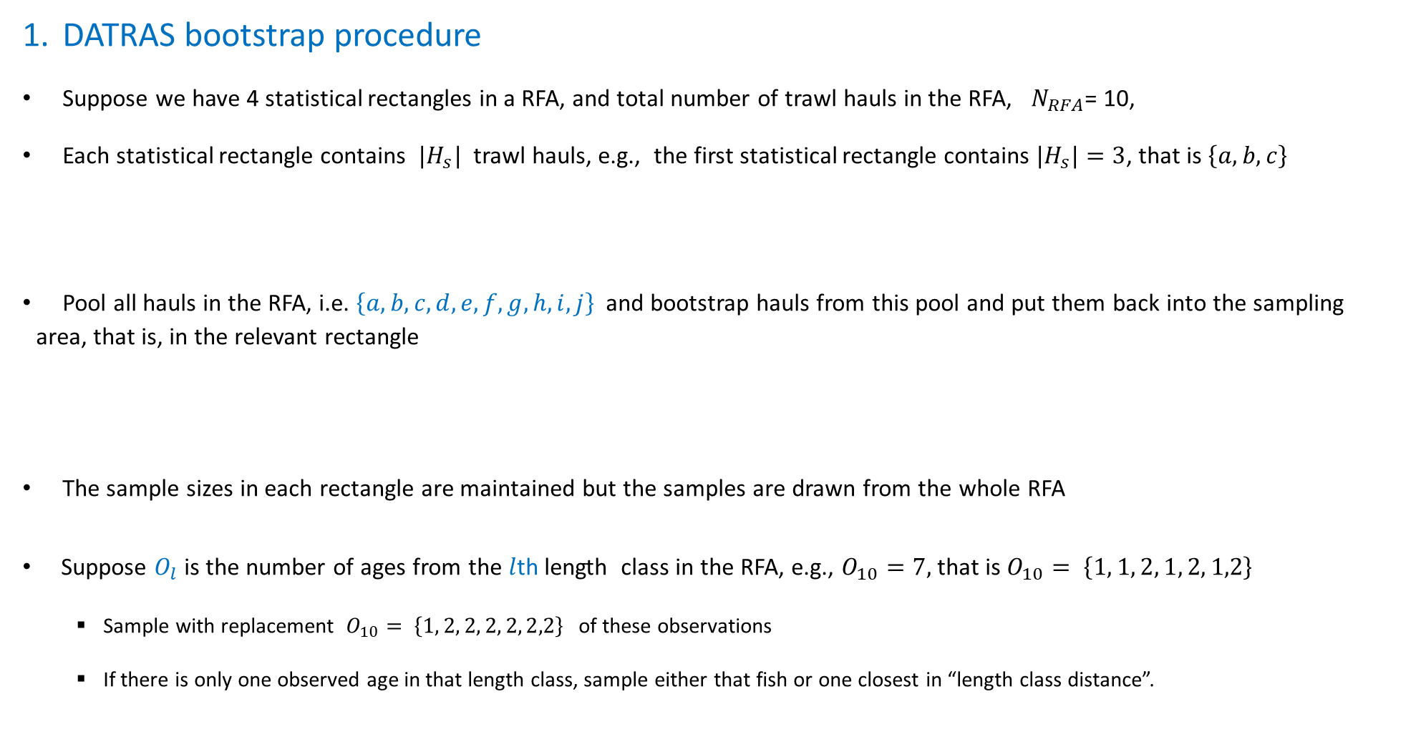
Uncertainty Estimation
DATRAS bootstrap procedure
Suppose we have 4 statistical rectangles in a RFA, and total number of trawl hauls in the RFA, $N_{RFA}$= 10,
Each statistical rectangle contains ${|H}_{s}|$ trawl hauls, e.g., the first statistical rectangle contains ${|H}_{s}|=3$, that is $\left\{a, b, c\right\}$
Pool all hauls in the RFA, i.e. $\left\{a, b, c, d, e, f, g, h, i, j\right\}$ and bootstrap hauls from this pool and put them back into the sampling area, that is, in the relevant rectangle
The sample sizes in each rectangle are maintained but the samples are drawn from the whole RFA
Suppose $O_{l}$ is the number of ages from the $l$th length class in the RFA, e.g., $O_{10}=7,$ that is $O_{10}= \left\{1, 1, 2, 1, 2, 1,2\right\}$
Sample with replacement $O_{10}= \left\{1, 2, 2, 2, 2, 2,2\right\}$ of these observations
If there is only one observed age in that length class, sample either that fish or one closest in “length class distance”.

Slide 17
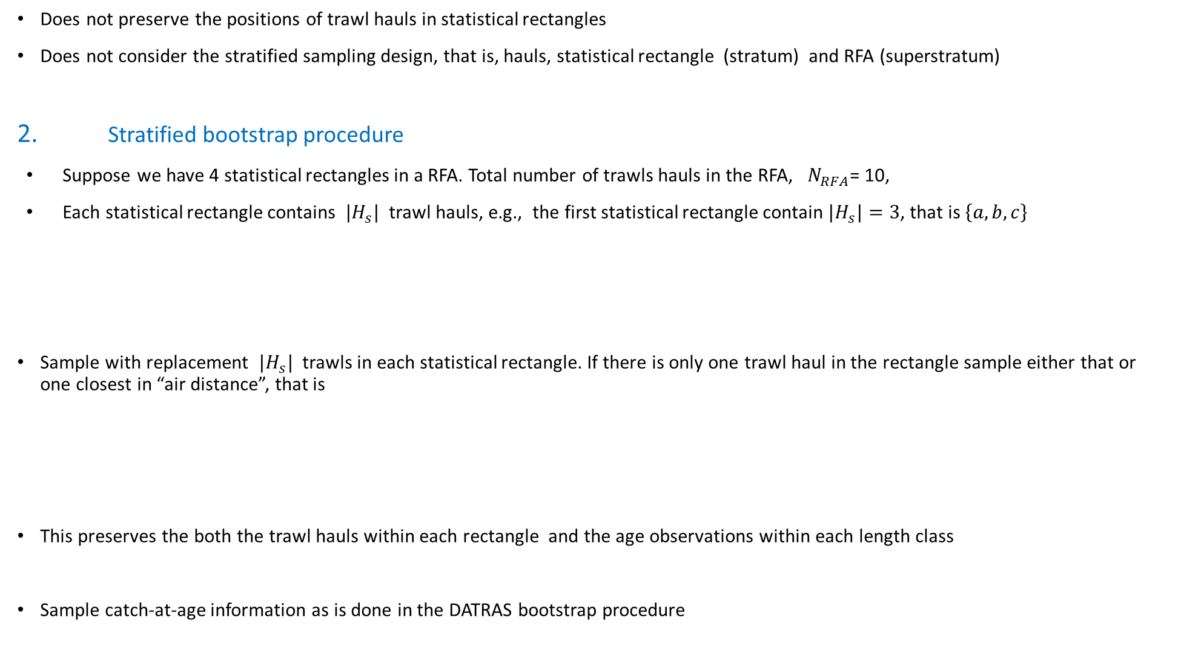
Uncertainty Estimation
Does not preserve the positions of trawl hauls in statistical rectangles
Does not consider the stratified sampling design, that is, hauls, statistical rectangle (stratum) and RFA (superstratum)
2. Stratified bootstrap procedure
Suppose we have 4 statistical rectangles in a RFA. Total number of trawls hauls in the RFA, $N_{RFA}$= 10,
Each statistical rectangle contains ${|H}_{s}|$ trawl hauls, e.g., the first statistical rectangle contain ${|H}_{s}|=3$, that is $\left\{a, b, c\right\}$
Sample with replacement ${|H}_{s}|$ trawls in each statistical rectangle. If there is only one trawl haul in the rectangle sample either that or one closest in “air distance”, that is
This preserves the both the trawl hauls within each rectangle and the age observations within each length class
Sample catch-at-age information as is done in the DATRAS bootstrap procedure

Slide 18
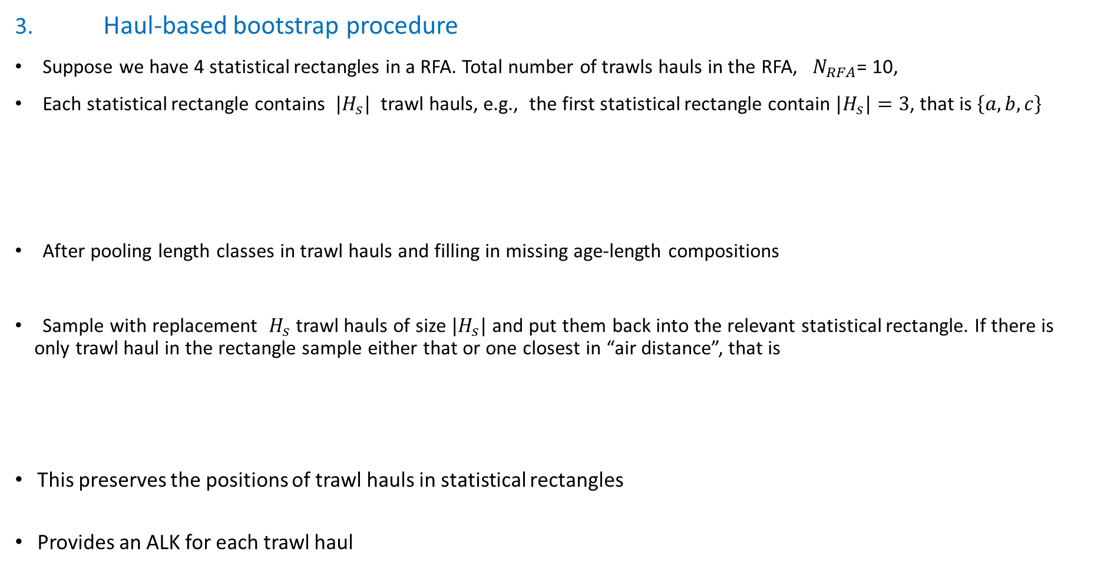
Uncertainty Estimation
3. Haul-based bootstrap procedure
Suppose we have 4 statistical rectangles in a RFA. Total number of trawls hauls in the RFA, $N_{RFA}$= 10,
Each statistical rectangle contains ${|H}_{s}|$ trawl hauls, e.g., the first statistical rectangle contain ${|H}_{s}|=3$, that is $\left\{a, b, c\right\}$
After pooling length classes in trawl hauls and filling in missing age-length compositions
Sample with replacement $H_{s}$trawl hauls of size ${|H}_{s}|$ and put them back into the relevant statistical rectangle. If there is only trawl haul in the rectangle sample either that or one closest in “air distance”, that is
This preserves the positions of trawl hauls in statistical rectangles
Provides an ALK for each trawl haul

Slide 19
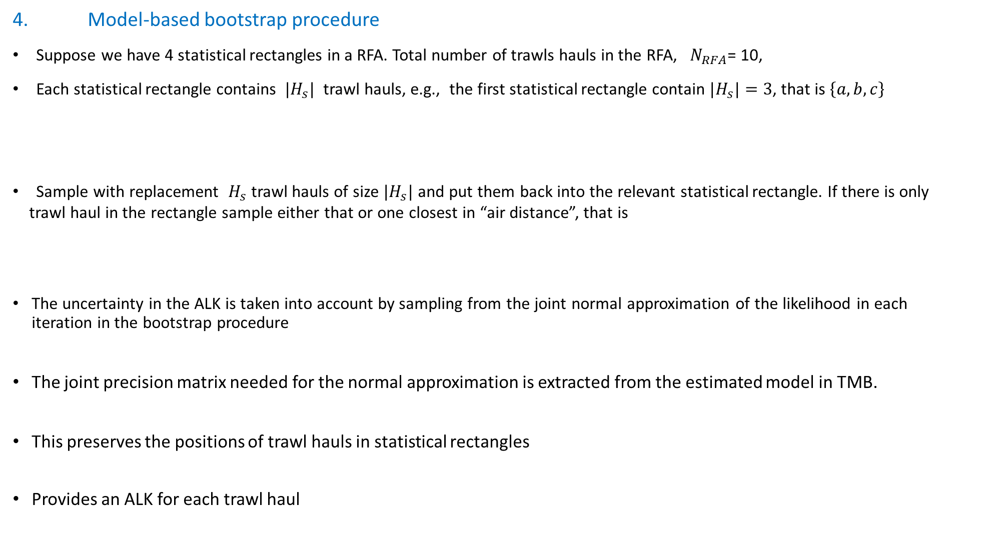
Uncertainty Estimation
4. Model-based bootstrap procedure
Suppose we have 4 statistical rectangles in a RFA. Total number of trawls hauls in the RFA, $N_{RFA}$= 10,
Each statistical rectangle contains ${|H}_{s}|$ trawl hauls, e.g., the first statistical rectangle contain ${|H}_{s}|=3$, that is $\left\{a, b, c\right\}$
Sample with replacement $H_{s}$trawl hauls of size ${|H}_{s}|$ and put them back into the relevant statistical rectangle. If there is only trawl haul in the rectangle sample either that or one closest in “air distance”, that is
The uncertainty in the ALK is taken into account by sampling from the joint normal approximation of the likelihood in each iteration in the bootstrap procedure
The joint precision matrix needed for the normal approximation is extracted from the estimated model in TMB.
This preserves the positions of trawl hauls in statistical rectangles
Provides an ALK for each trawl haul

Slide 20
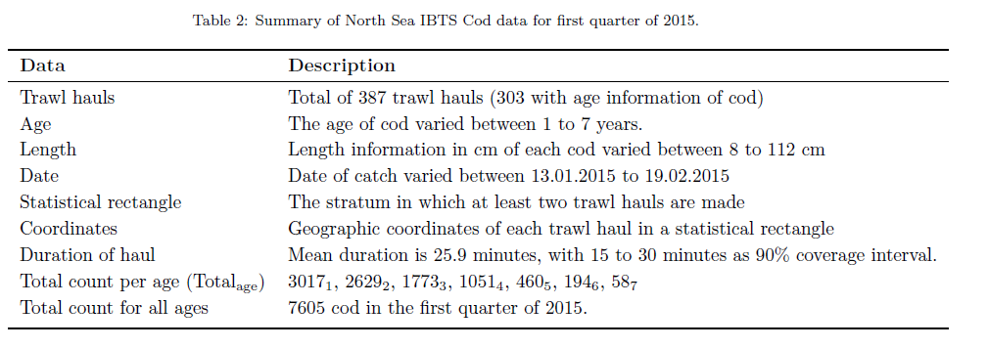
The North Sea Cod Data
Brief description of cod data in Q1 of 2015

Slide 21
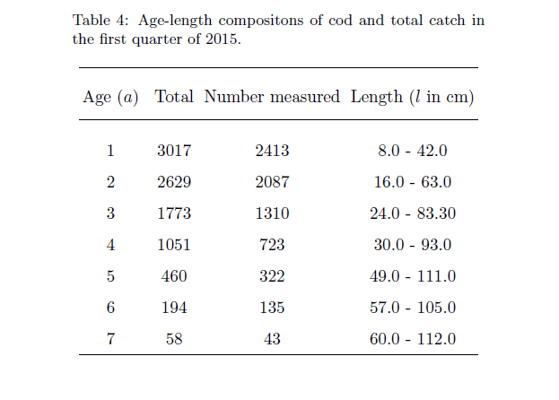
The North Sea Cod Data
Smaller samples for larger age-length groups
Higher catch rates for smaller, younger fish

Slide 22
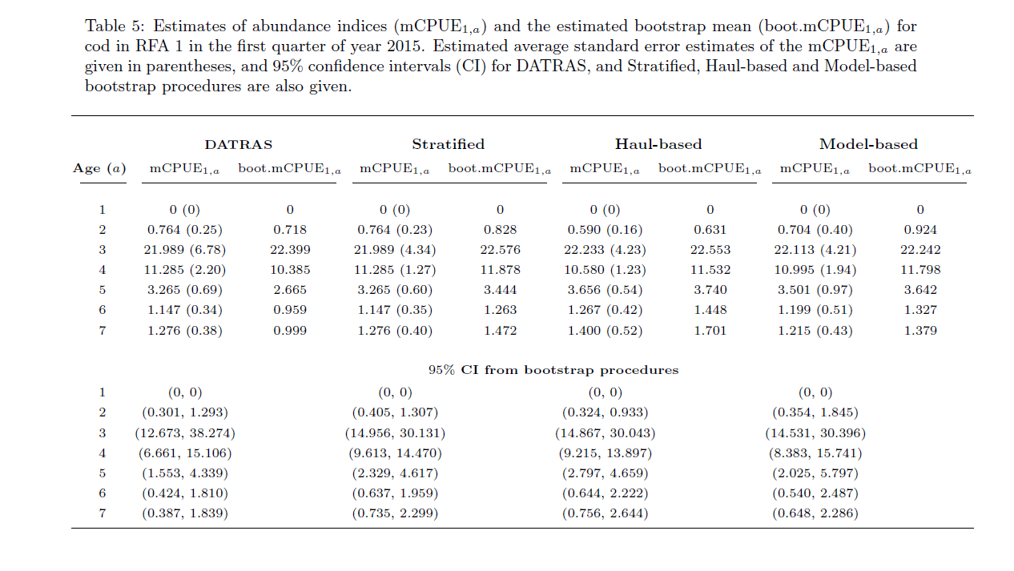
Results
Model-based ALK generally performs better in terms of uncertainty estimation. Accounts for Spatial differences in age-length structures
DATRAS procedure generally gave smaller estimates of uncertainty as it lacks the potential to account for spatial variation in the data
Estimated CPUE at age is captured within a 95% CI for all methods

Slide 23
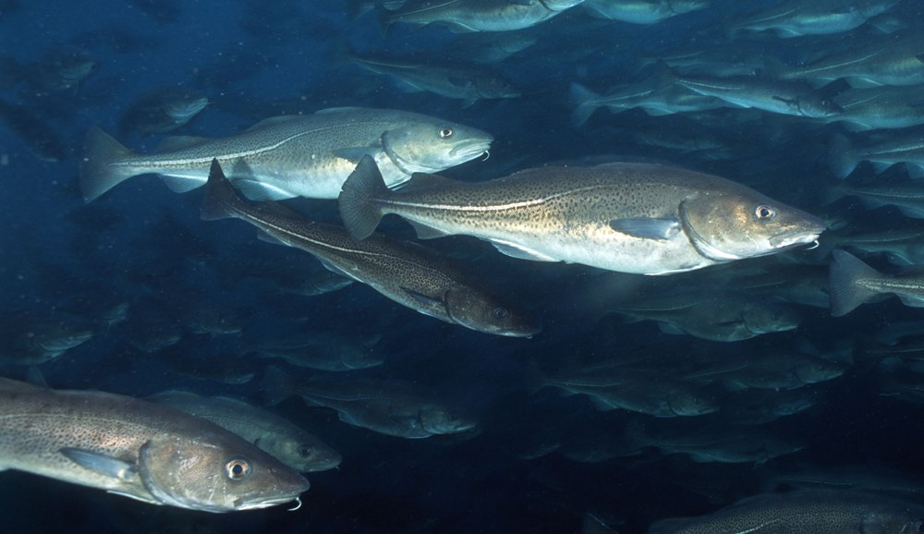
Thank you
Questions?

Slide 24
Questions
Vessels are free to choose trawling positions in the statistical rectangle but check for “clear” tow. Is this still being done, if not when did each nation stopped, and what has each nation been doing?
Locations are randomly selected in advance from trawlable positions made from 2000-2017 (IBTS Q1 sampling procedure document has this information). When has this started, and have all nations been involved in this from its start, if no when has this been adopted by each nation?
Sampling of otoliths:
ICES suggested the sampling procedure in the following Table 7 (on the next slide) per ROUND FISH AREA
to 0.1cm below for shellfish,
to 0.5cm below for herring and sprat and
to 1cm below for all other species
Norway has been sampling 1 otolith per length class per TRAWL HAUL when Jennifer Devine took over IBTS Norway. What year was this (2013)? Have the other countries been sampling this way too, if so from when?
ICES suggested that from 2018 samples of otoliths per length class should be take from all TRAWL HAULS and not ROUND FISH AREAS, special instructions for Whiting and Norway pout (see Table 7, next slide) . Have all countries adopted the changes, if not what has been done by each nation?

Slide 25
Questions

Slide 26
Questions
Are the primary sampling units SWEPT-AREA trawl hauls?
ICES suggested more than two trawl hauls be taken in the following areas in the Eastern English Channel, Southern North Sea and Central North Sea. Why is this the case, and is this sampling strategy still being adopted by the nations who typically fish in these areas?
at least 3 hauls per rectangle are taken in statistical rectangles 31F1, 31F2, 32F1, 33F4, 34F2, 34F3, 34F4, 35F3, 35F4;
while six or more hauls per rectangle are taken in statistical rectangles 30F1, 32F2, 32F3, 33F2, 33F3 (ICES 1999)
There are some guidelines in ICES documentation regarding door spread and headline height (See Figure 5 on next slide). Are all countries applying these guidelines, if not what guidelines are adopted by each nation?
ICES suggested that in some rectangles weights based on its surface area must be attached (see Table with weights) and CPUE estimates for herring, sprat and saithe must be adjusted by these weights. Why is this not applied to all fish species caught in these areas?

Slide 27
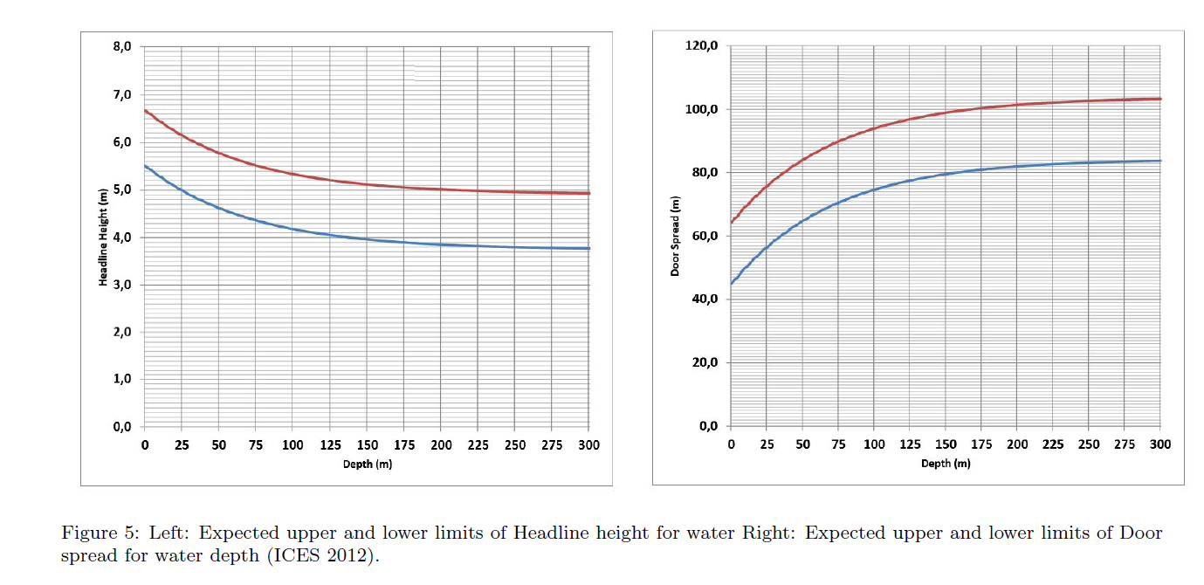
Questions

Slide 28
Questions

Slide 29
Questions
The standard gear is the GOV with either of two gears
Ground gear “A” for smooth bottom
Ground gear “B” for rough bottom
With an ``Exocet" kite and five floats attached to this kite
Does each nation uses a combination of these gears during surveys or a single gear (which)?

Slide 30

Results
Model-based bootstrap procedure
Suppose we have 4 statistical rectangles in a RFA
Each statistical rectangle contains ${|H}_{s}|$ trawl hauls, e.g., the first statistical rectangle contain ${|H}_{s}|=3$, that is $\left\{a, b, c\right\}$
Total number of trawls hauls in the RFA, $N_{RFA}$= 10,

Slide 31
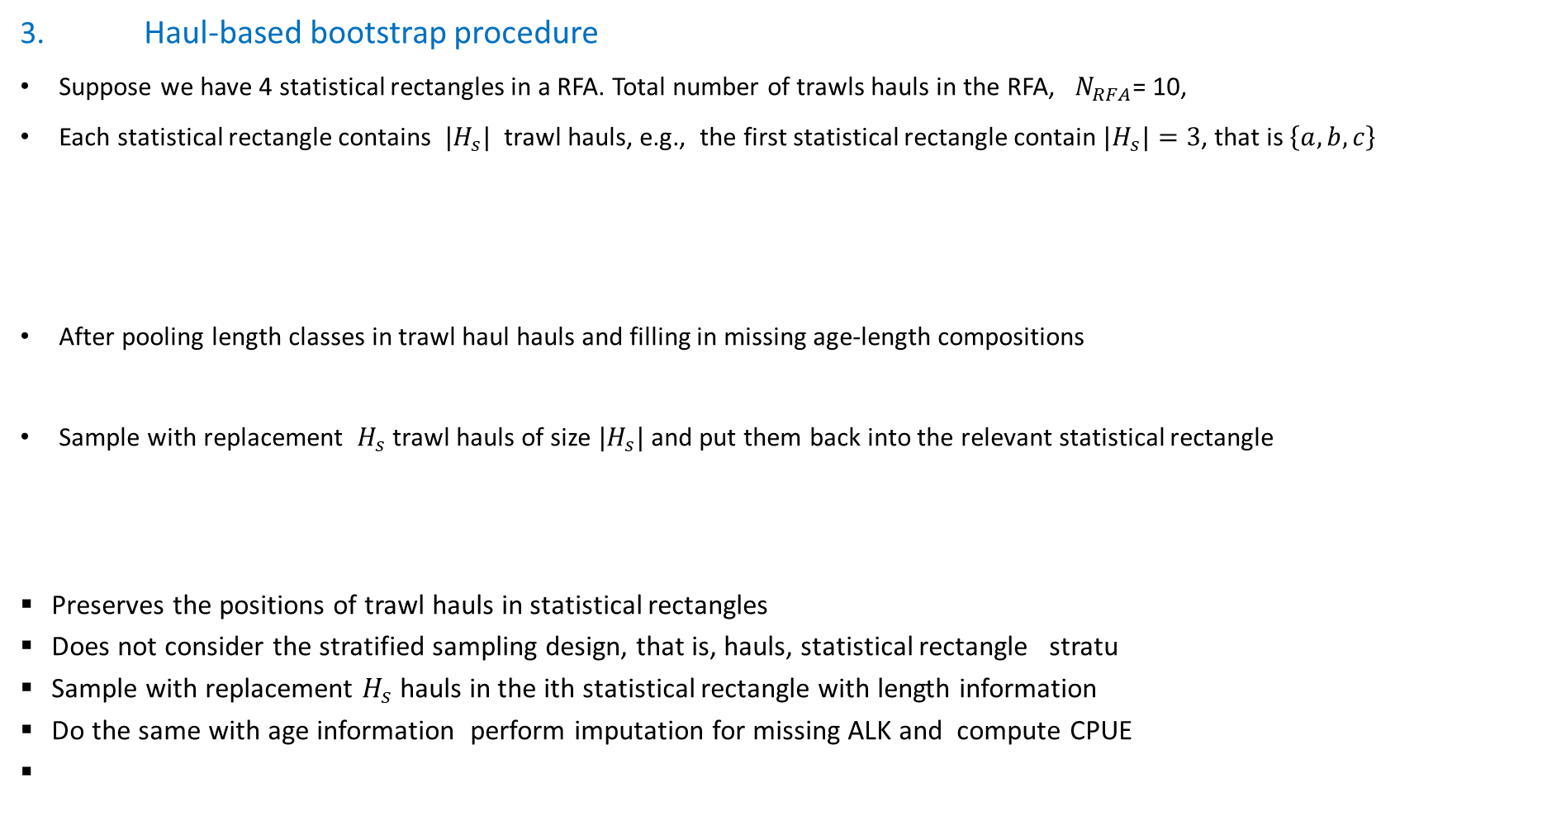
Uncertainty Estimation
3. Haul-based bootstrap procedure
Suppose we have 4 statistical rectangles in a RFA. Total number of trawls hauls in the RFA, $N_{RFA}$= 10,
Each statistical rectangle contains ${|H}_{s}|$ trawl hauls, e.g., the first statistical rectangle contain ${|H}_{s}|=3$, that is $\left\{a, b, c\right\}$
After pooling length classes in trawl haul hauls and filling in missing age-length compositions
Sample with replacement $H_{s}$trawl hauls of size ${|H}_{s}|$ and put them back into the relevant statistical rectangle
Preserves the positions of trawl hauls in statistical rectangles
Does not consider the stratified sampling design, that is, hauls, statistical rectangle stratu
Sample with replacement $H_{s}$hauls in the ith statistical rectangle with length information
Do the same with age information perform imputation for missing ALK and compute CPUE

Slide 32

Uncertainty Estimation
4. Model-based bootstrap procedure
Suppose we have 4 statistical rectangles in a RFA
Each statistical rectangle contains ${|H}_{s}|$ trawl hauls, e.g., the first statistical rectangle contain ${|H}_{s}|=3$, that is $\left\{a, b, c\right\}$
Total number of trawls hauls in the RFA, $N_{RFA}$= 10,

Slide 33



Uncertainty Estimation
DATRAS bootstrap procedure
Suppose we have 4 statistical rectangles in a RFA
Each statistical rectangle contains ${|H}_{s}|$ trawl hauls, e.g., the first statistical rectangle contains ${|H}_{s}|=3$, that is $\left\{a, b, c\right\}$
Total number of trawls hauls in the RFA, $N_{RFA}$= 10,
a b c d e f g h i j
Pool all hauls in the RFA, that is $\left\{a, b, c, d, e, f, g, h, i, j\right\}$ and bootstrap hauls from this pool and put them back into the sampling area, that is relevant rectangle
a a d d d a f f b i
Does not preserve the positions of trawl hauls in statistical rectangles
Does not consider the stratified sampling design, that is, hauls, statistical rectangle stratu

Slide 34

Uncertainty Estimation
2. Stratified bootstrap procedure
Suppose we have 4 statistical rectangles in a RFA
Each statistical rectangle contains ${|H}_{s}|$ trawl hauls, e.g., the first statistical rectangle contain ${|H}_{s}|=3$, that is $\left\{a, b, c\right\}$
Total number of trawls hauls in the RFA, $N_{RFA}$= 10,
a b c d e f g h i j
Sample with replacement $H_{s}$trawl hauls of size ${|H}_{s}|$ and put them back into the relevant statistical rectangle
a a a d d f f f h i
Preserves the positions of trawl hauls in statistical rectangles
Does not consider the stratified sampling design, that is, hauls, statistical rectangle stratu

Slide 35

Uncertainty Estimation
DATRAS bootstrap procedure
Suppose we have 4 statistical rectangles in a RFA
Each statistical rectangle contains${|H}_{s}|$ trawl hauls, e.g., the first statistical rectangle contain ${|H}_{s}|=3$, that is $\left\{a, b, c\right\}$
Total number of trawls hauls in the RFA, $N_{RFA}$= 10
a b c d e f g h i j
Sample with replacement 10 trawl hauls within the RFA
a a d d d a f f b i
Stratified bootstrap procedure
Haul-based bootstrap procedure
Model-based bootstrap procedure

Slide 36
Methods
DATRAS ALK
Haul-Based ALK
Each trawl haul has an ALK
Length classes are grouped
Search closest neighbour trawls in air distance for age-length compositions, if there are none
Fill in missing values using DATRAS approach
Model-Based ALK

Slide 37
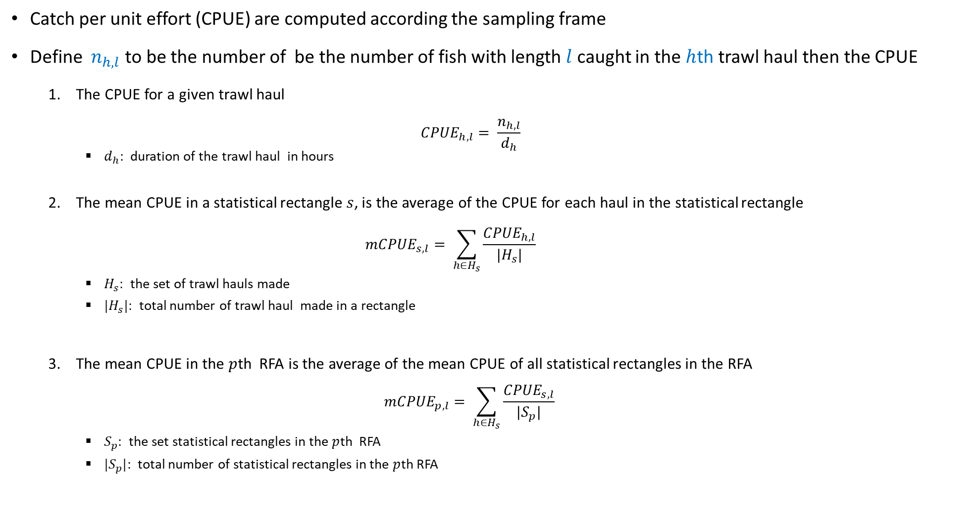
Methods
Catch per unit effort (CPUE) are computed according the sampling frame
Define $n_{h,l}$ to be the number of be the number of fish with length $l$ caught in the $h$th trawl haul then the CPUE
The CPUE for a given trawl haul
$${CPUE}_{h,l}= \frac{n_{h,l}}{d_{h}}$$
$d_{h}:$ duration of the trawl haul in hours
The mean CPUE in a statistical rectangle $s$, is the average of the CPUE for each haul in the statistical rectangle
$${mCPUE}_{s,l}= \sum_{h∈H_{s}}{\frac{{CPUE}_{h,l}}{|H_{s}|}}$$
$H_{s}:$ the set of trawl hauls made
${|H}_{s}|:$ total number of trawl haul made in a rectangle
The mean CPUE in the $p$th RFA is the average of the mean CPUE of all statistical rectangles in the RFA
$${mCPUE}_{p,l}= \sum_{h∈H_{s}}{\frac{{CPUE}_{s,l}}{|S_{p}|}}$$
$S_{p}:$ the set statistical rectangles in the $p$th RFA
${|S}_{p}|:$ total number of statistical rectangles in the $p$th RFA

Slide 38
Methods
Catch per unit effort (CPUE) are computed using an age-Length Key (ALK) method
An ALK is defined as the …………..
ICES proposed ALK estimator for IBTS in DATRAS is defined as follows:
An aggregation of …….
Disadvantages of this ALK Estimator
Lacks the potential to account for spatial variation in the data, for instance
Variance is estimated using nonparametric bootstrapping:
Disadvantages of this bootstrap approach

Slide 39
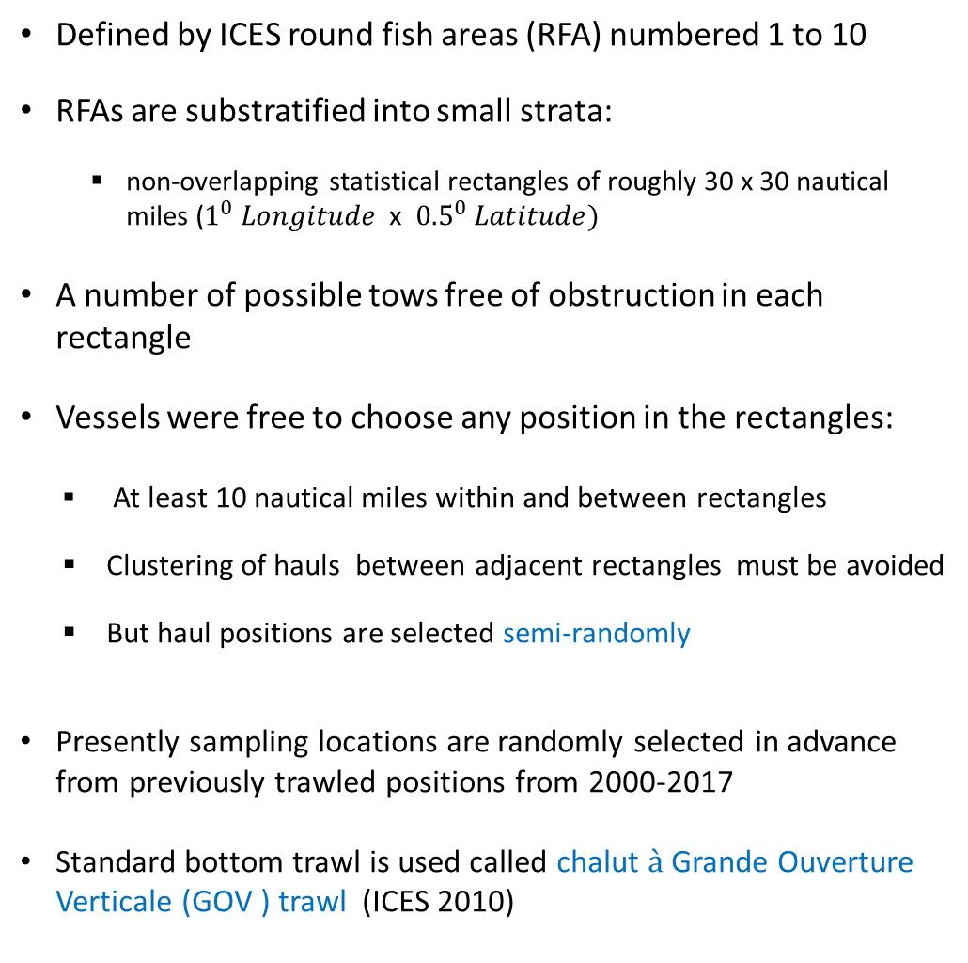
Sampling frame
Defined by ICES round fish areas (RFA) numbered 1 to 10
RFAs are substratified into small strata:
non-overlapping statistical rectangles of roughly 30 x 30 nautical miles ($1^{0} Longitude$x ${0.5}^{0} Latitude)$
A number of possible tows free of obstruction in each rectangle
Vessels were free to choose any position in the rectangles:
At least 10 nautical miles within and between rectangles
Clustering of hauls between adjacent rectangles must be avoided
But haul positions are selected semi-randomly
Presently sampling locations are randomly selected in advance from previously trawled positions from 2000-2017
Standard bottom trawl is used called chalut $\grave{a}$ Grande Ouverture Verticale (GOV ) trawl (ICES 2010)

Slide 40
Overview of IBST
The North Sea IBTS was started by ICES in 1990
IBTS is combination of the following surveys which started in the 1960’s and the 1970’s and 1980’s:
The International Young Herring Survey (IYHS) in the North Sea, Skagerrak and Kattegat areas, and
8 national surveys
The aim of IYHS:
To obtain annual recruitment indices for the combined North Sea Herring stock, but
Valuable information on other species such as cod and haddock were obtained
The North Sea IBTS began with quarterly surveys but these became expensive to sustain as countries experience budget cuts
In 1997 countries carried surveys only twice a year
The first quarter (Q1) which is January – February: 7 nations take part
The third quarter (Q3) which is between July – August: 6 nations take part
These nations include: Denmark, France, Germany, Netherlands, Norway UK England, UK Scotland and Sweden

Slide 41
Sampling frame
Trawling is done during the day (15 minutes before sunrise and 15 minutes after sunset) at 3.5 – 4.5 knots
Two nations fish in each rectangle, hence, at least two hauls
Total catches for each trawl haul are made on board
Biological parameters such and length are collected for all fish species
to 0.1cm below for shellfish,
to 0.5cm below for herring and sprat and
to 1cm below for all other species
For large catches a subsample of 100 fish is taken
otoliths

Slide 42
Methods
We propose two ALK estimators that accounts for spatial variation in the data:
Haul-based ALK
Accounts for spatial variation
Model-based ALK
blahhhh

